Slide 1
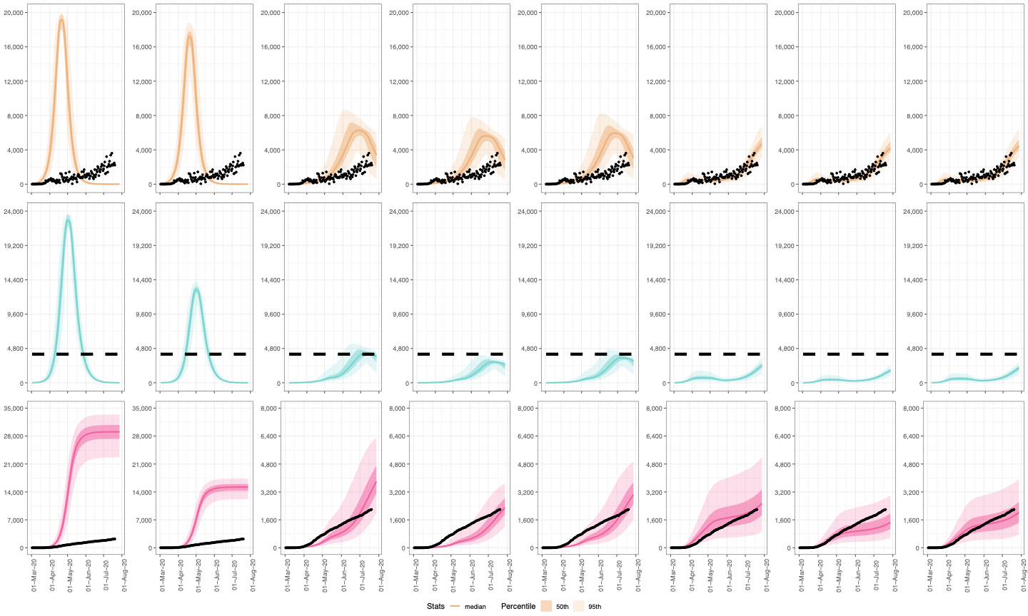
1
2
3
4
5
6
7
8
NPIs: None
Protect: Observed
NPIs: None
Protect: High
NPIs: Moderate
Protect: Observed
NPIs: Moderate
Protect: High
NPIs: Moderate
Protect: Moderate
NPIs: Observed
Protect: Observed
NPIs: Observed
Protect: High
NPIs: Observed
Protect: Moderate
New
Observed
Illnesses
Current
Hospitalizations
Cumulative
Deaths

Slide 3
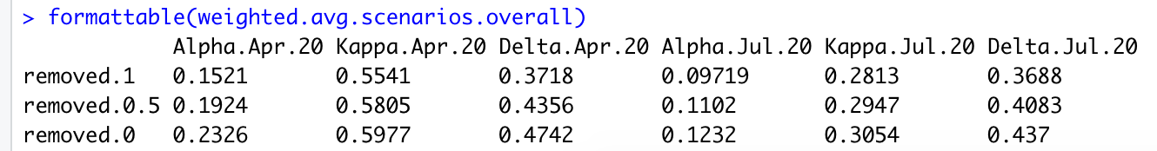
Scenarios: With integrated risk model and epidemic model
1
2
3
4
5
6
7
8
NPIs: None
Protect: Observed
NPIs: None
Protect: High
NPIs: Moderate
Protect: Observed
NPIs: Moderate
Protect: High
NPIs: Moderate
Protect: Moderate
NPIs: Observed
Protect: Observed
NPIs: Observed
Protect: High
NPIs: Observed
Protect: Moderate
New
Observed
Illnesses
Current
Hospitalizations
Cumulative
Deaths

Slide 4
Scenarios: isolating 65+ using risk model
## 1 SCENARIO: R0 DO NOTHING → NPIs = None
## 2 SCENARIO: NPIs = None + Isolate 65+ 100%
## 3 SCENARIO: Go immediately into STAGE 3 → NPIs = Moderate
## 4 SCENARIO: NPIs = Moderate + Isolate 65+ 100%
## 5 SCENARIO: NPIs = Moderate + Isolate 65+ 50%
## 6 SCENARIO: OBSERVED TREND → NPIs = Observed
## 7 SCENARIO: NPIs = Observed + Isolate 65+ 100%
## 8 SCENARIO: NPIs = Observed + Isolate 65+ 50%

Slide 5
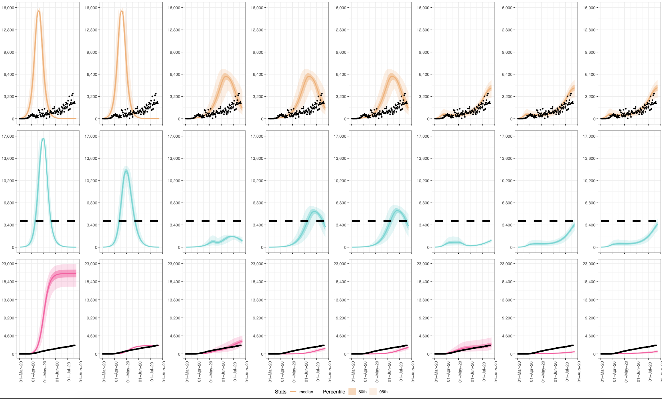
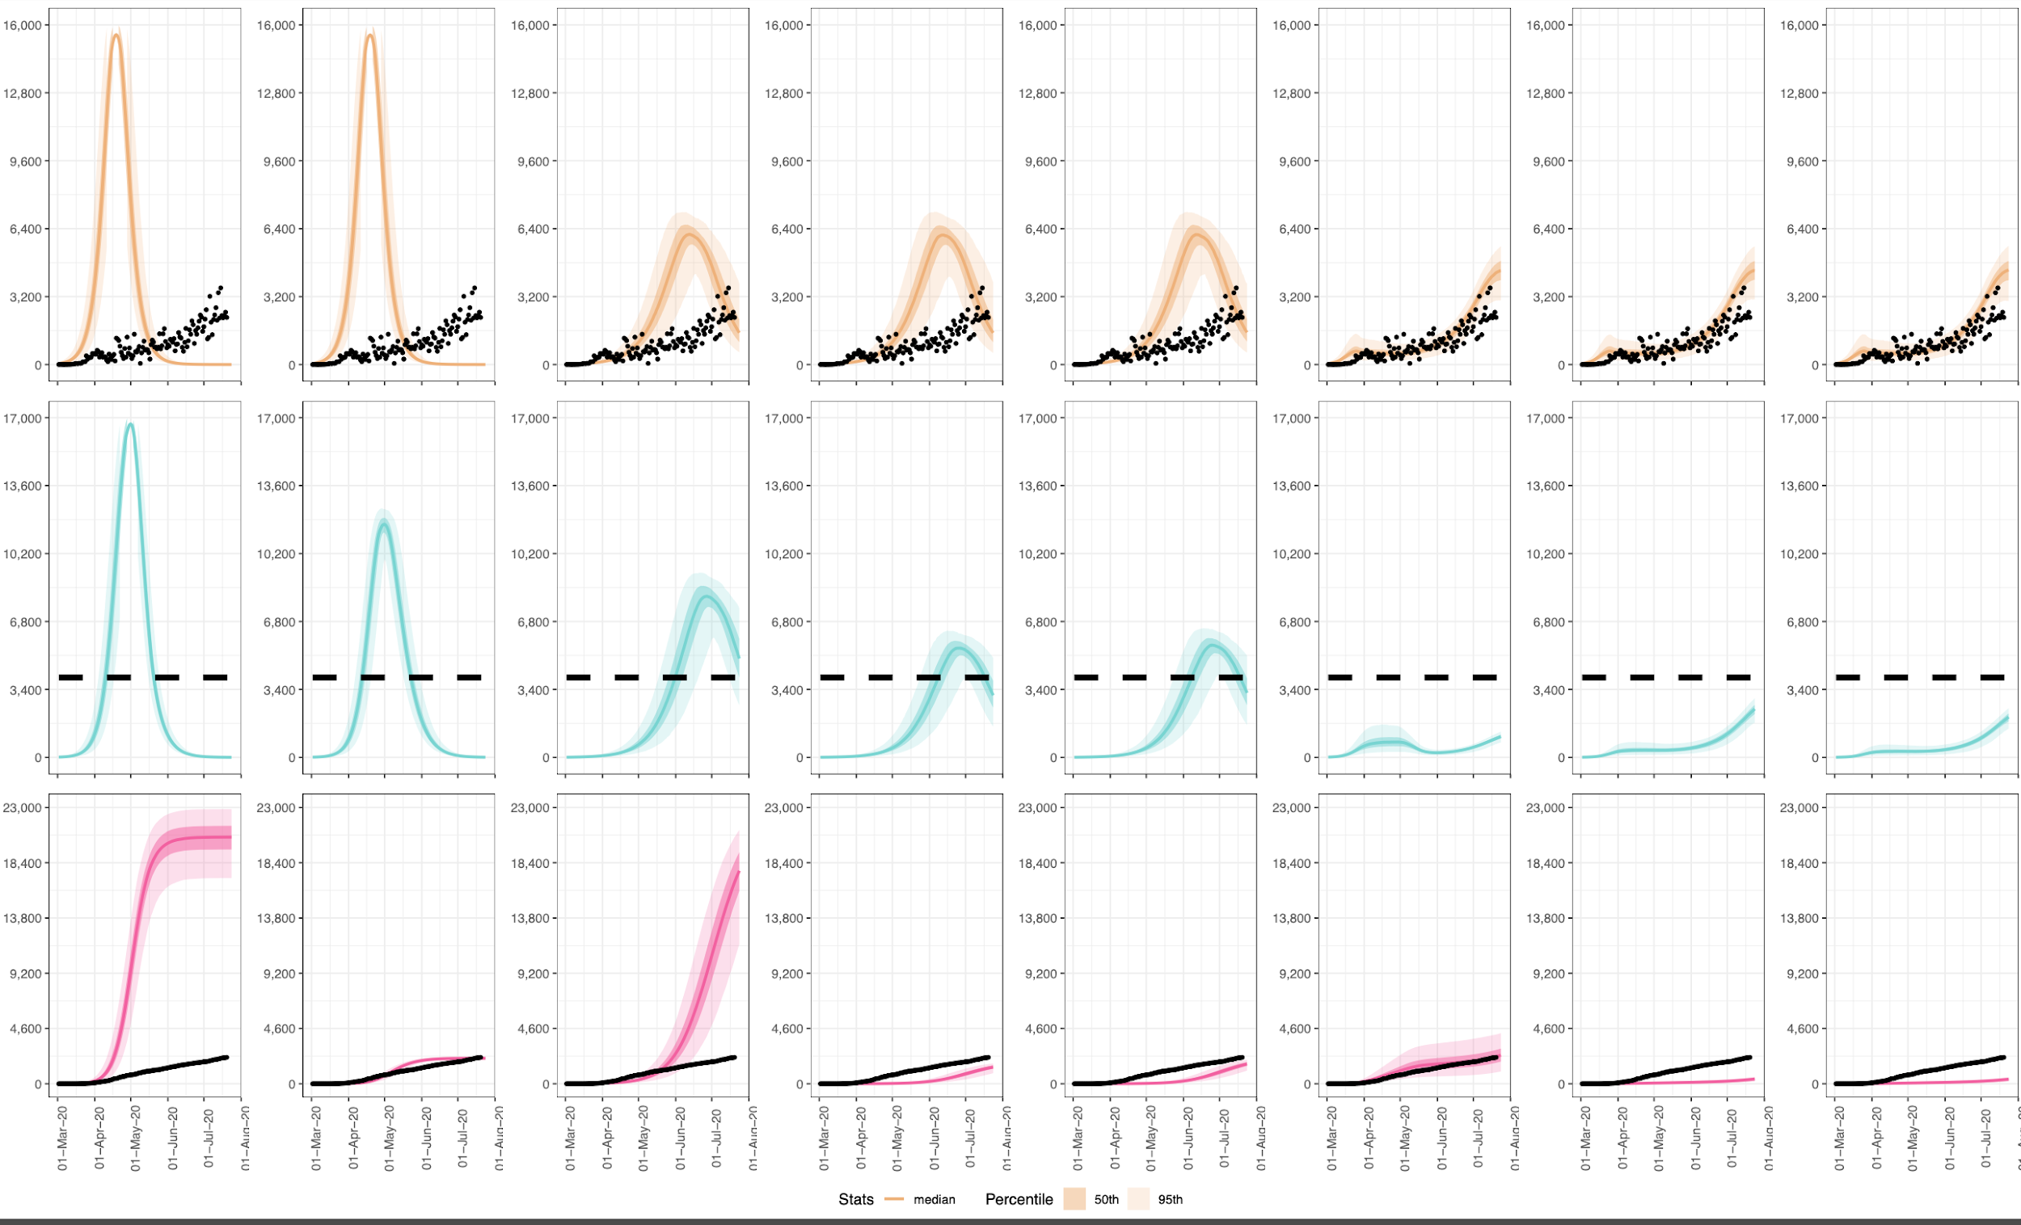
Scenarios: Isolating 65+ using the risk model
Scenarios: Isolating 65+ using risk model calculations
1
2
3
4
5
6
7
8
NPIs: None
Protect: Observed
NPIs: None
Protect: High
NPIs: Moderate
Protect: Observed
NPIs: Moderate
Protect: High
NPIs: Moderate
Protect: Moderate
NPIs: Observed
Protect: Observed
NPIs: Observed
Protect: High
NPIs: Observed
Protect: Moderate
New
Observed
Illnesses
Current
Hospitalizations
Cumulative
Deaths

Slide 6
Scenarios: Going immediately to Alpha, Kappa, Delta in June/July
## 1 SCENARIO: R0 DO NOTHING → NPIs = None
## 2 SCENARIO: NPIs = None + Go immediately to Alpha,Kappa,Delta in June/July → Protect = High
## 3 SCENARIO: Go immediately into STAGE 3 → NPIs = Moderate
## 4 SCENARIO: NPIs = Moderate + Protect = High
## 5 SCENARIO: OBSERVED TREND → NPIs = Observed
## 6 SCENARIO: NPIs = Observed + Protect = High

Slide 7
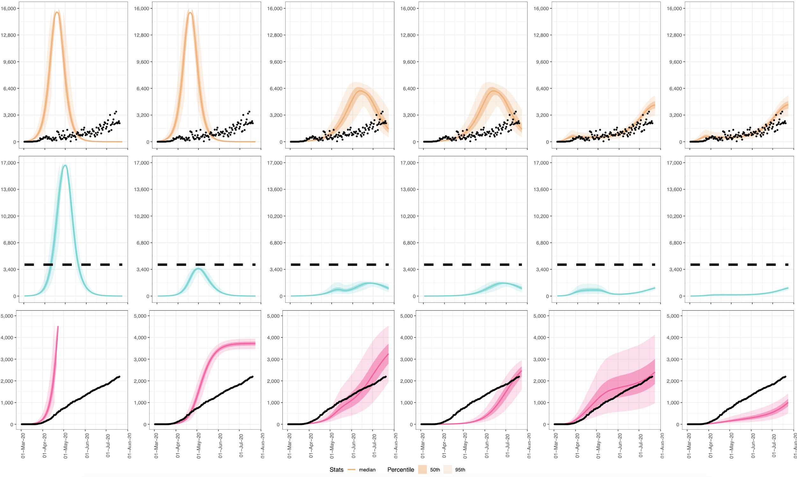
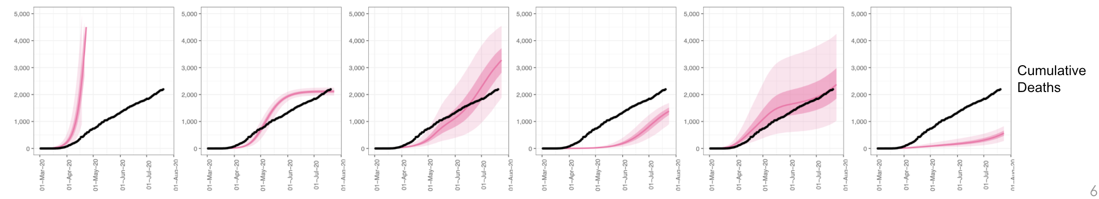
Scenarios: Isolating 65+ using risk model calculations :
Strong effect but likely unrealistic
Scenarios: Going immediately to Alpha, Kappa, Delta in June/July:
Still a good effect, and by definition is realistic
1
2
3
4
5
6
NPIs: None
Protect: Observed
NPIs: None
Protect: High
NPIs: Moderate
Protect: Observed
NPIs: Moderate
Protect: High
NPIs: Observed
Protect: Observed
NPIs: Observed
Protect: High
New
Observed
Illnesses
Current
Hospitalizations
Cumulative
Deaths

Slide 8
Scenarios: Going immediately to Alpha, Kappa, Delta in June/July
1
2
3
4
5
6
NPIs: None
Protect: Observed
NPIs: None
Protect: High
NPIs: Moderate
Protect: Observed
NPIs: Moderate
Protect: High
NPIs: Observed
Protect: Observed
NPIs: Observed
Protect: High
New
Observed
Illnesses
Current
Hospitalizations
Cumulative
Deaths

Slide 9
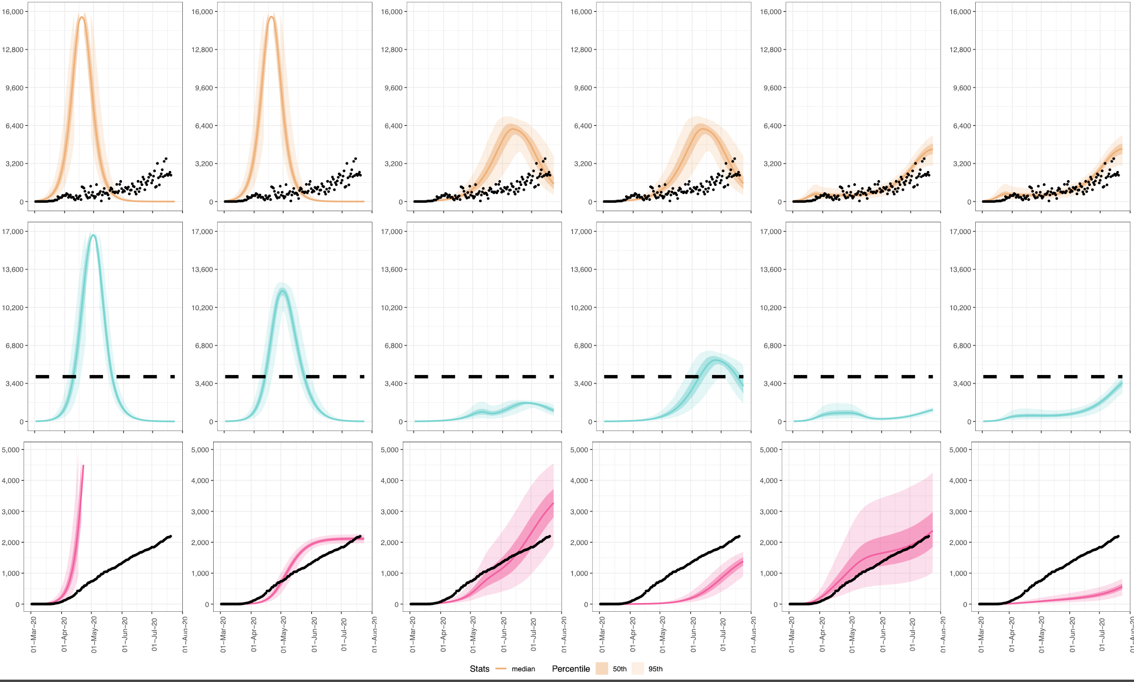
Scenarios: Isolating 65+ using risk model calculations (with lower upper bound on D and not including 50% scenarios)
1
2
3
4
5
6
NPIs: None
Protect: Observed
NPIs: None
Protect: 100%
NPIs: Moderate
Protect: Observed
NPIs: Moderate
Protect: 100%
NPIs: Observed
Protect: Observed
NPIs: Observed
Protect: 100%
New
Observed
Illnesses
Current
Hospitalizations
Cumulative
Deaths

Slide 10
Scenarios: Isolating 65+ using risk model calculations (with lower upper bound on D and not including 50% scenarios)
1
2
3
4
5
6
NPIs: None
Protect: Observed
NPIs: None
Protect: 100%
NPIs: Moderate
Protect: Observed
NPIs: Moderate
Protect: 100%
NPIs: Observed
Protect: Observed
NPIs: Observed
Protect: 100%
New
Observed
Illnesses
Current
Hospitalizations
Cumulative
Deaths

Slide 11
Analysis:
Risk Probabilities after pegging to LAC data on illnesses by age group

Slide 12
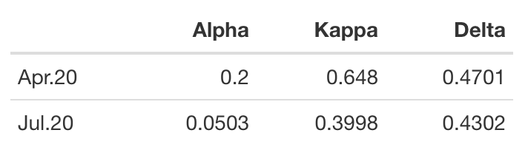
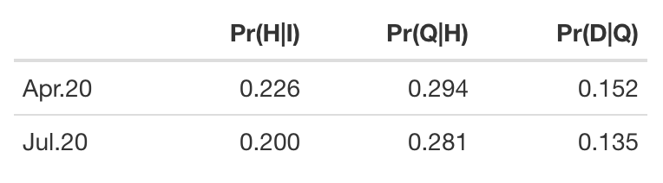
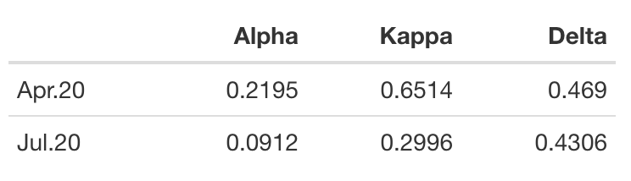
Analysis: Risk probabilities
Posterior Risk Probabilities
Prior Risk Probabilities
These priors are pegged to LAC data via the prevalence of each age group in the infected population on both these dates
These posteriors are fit to the epidemic model at both these dates and times in between
I think we replace our existing estimates for P(H|I) etc in the text with these.
I still need to plot these estimated functions for Alpha Kappa Delta over time

Slide 13
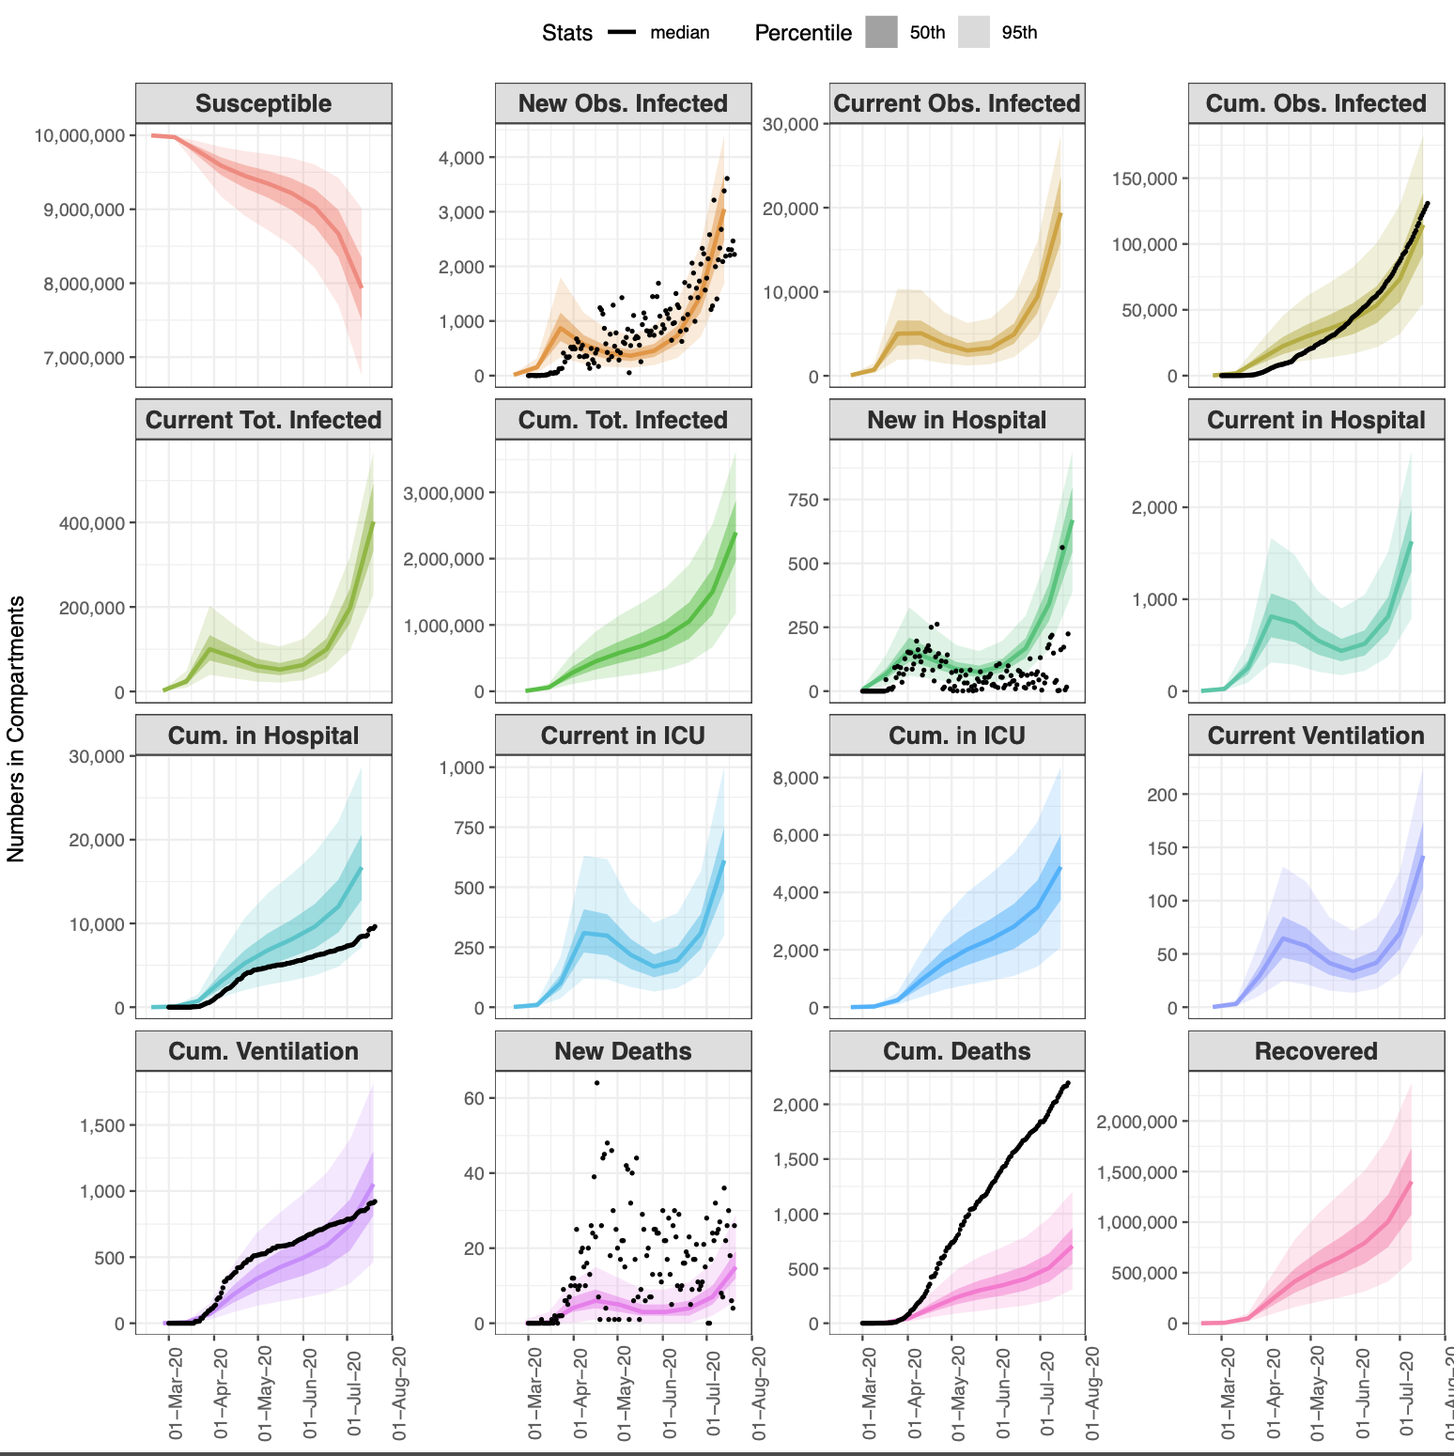
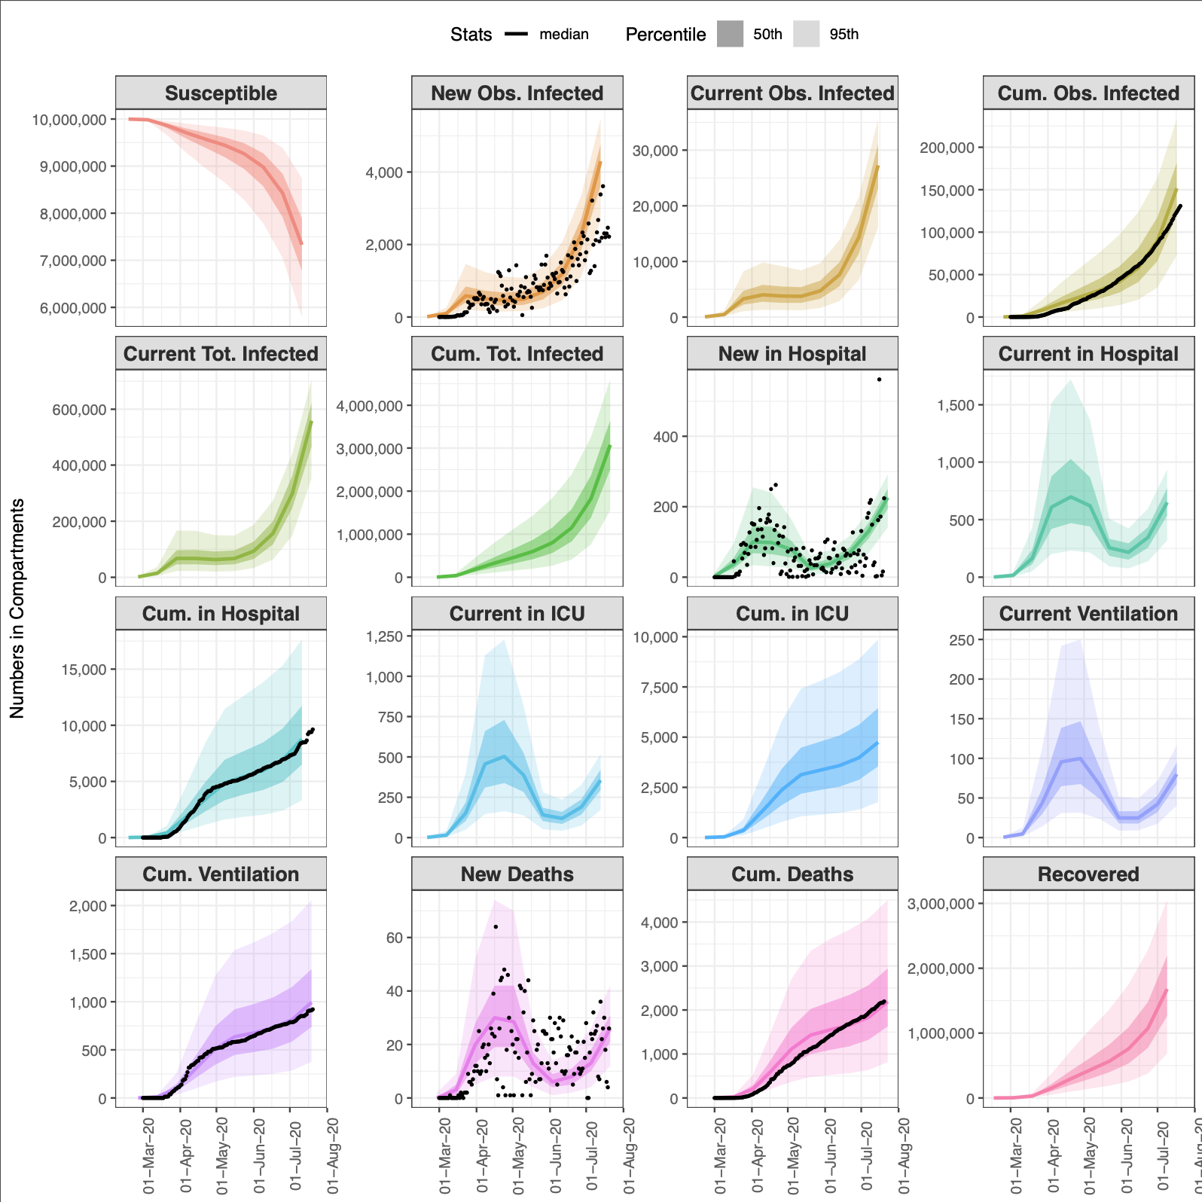
Analysis: Risk probabilities
Model fits when relaxing prior distributions (not fixing around Prior Risk probabilities)
Model fit using tight priors around Prior Risk Probabilities
Model fit using tight priors around Prior Risk Probabilities
When I fit the model to the Prior Risk Probabilities, even after pegging to LAC data on the prevalence of illnesses by age group -- the risk model over-estimates hospitalizations, and severely underestimates deaths.
Do we note this anywhere in the text?

Slide 15
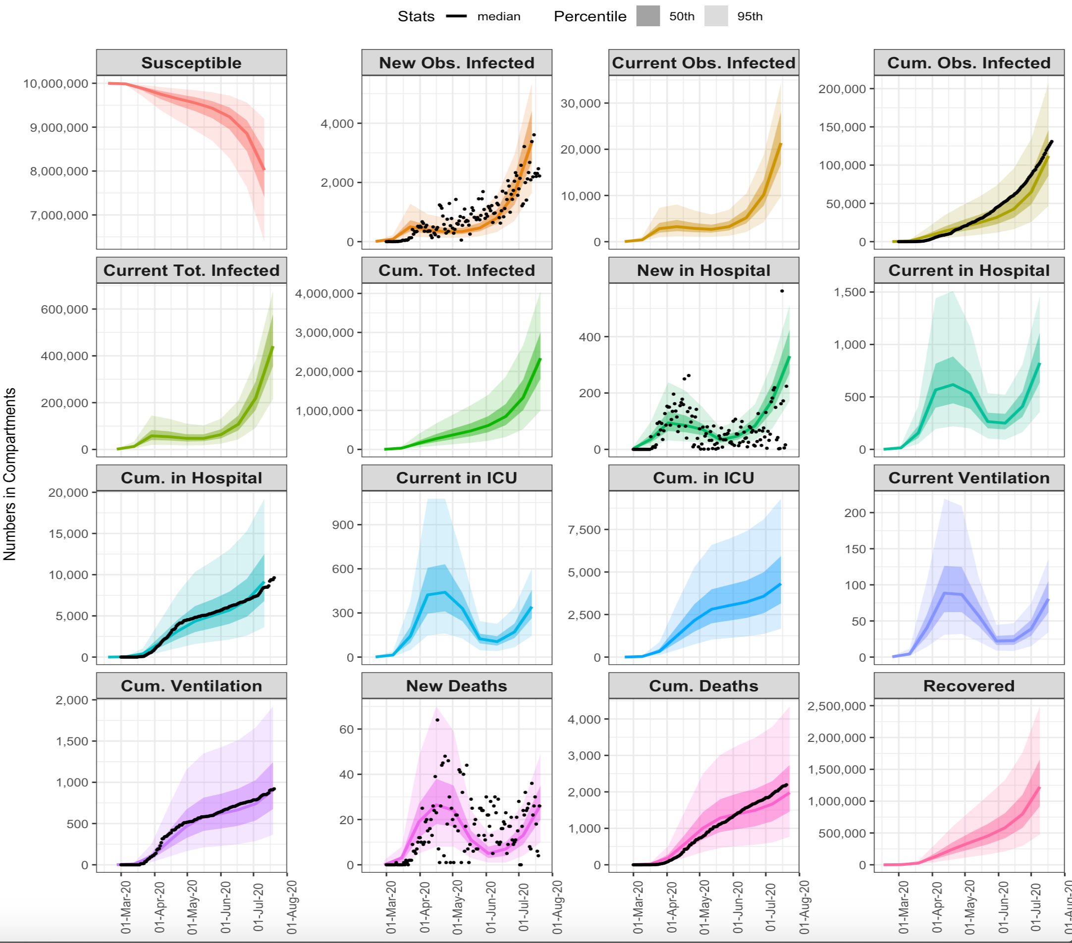
Analysis: Risk probabilities
Model fits WITH SLIGHTLY CLOSER POSTERIOR ALPHA KAPPA DELTA
Model fit using tight priors around Prior Risk Probabilities
Model fit using tight priors around Prior Risk Probabilities
When I fit the model to the Prior Risk Probabilities, even after pegging to LAC data on the prevalence of illnesses by age group -- the risk model over-estimates hospitalizations, and severely underestimates deaths.
Do we note this anywhere in the text?

Slide 16
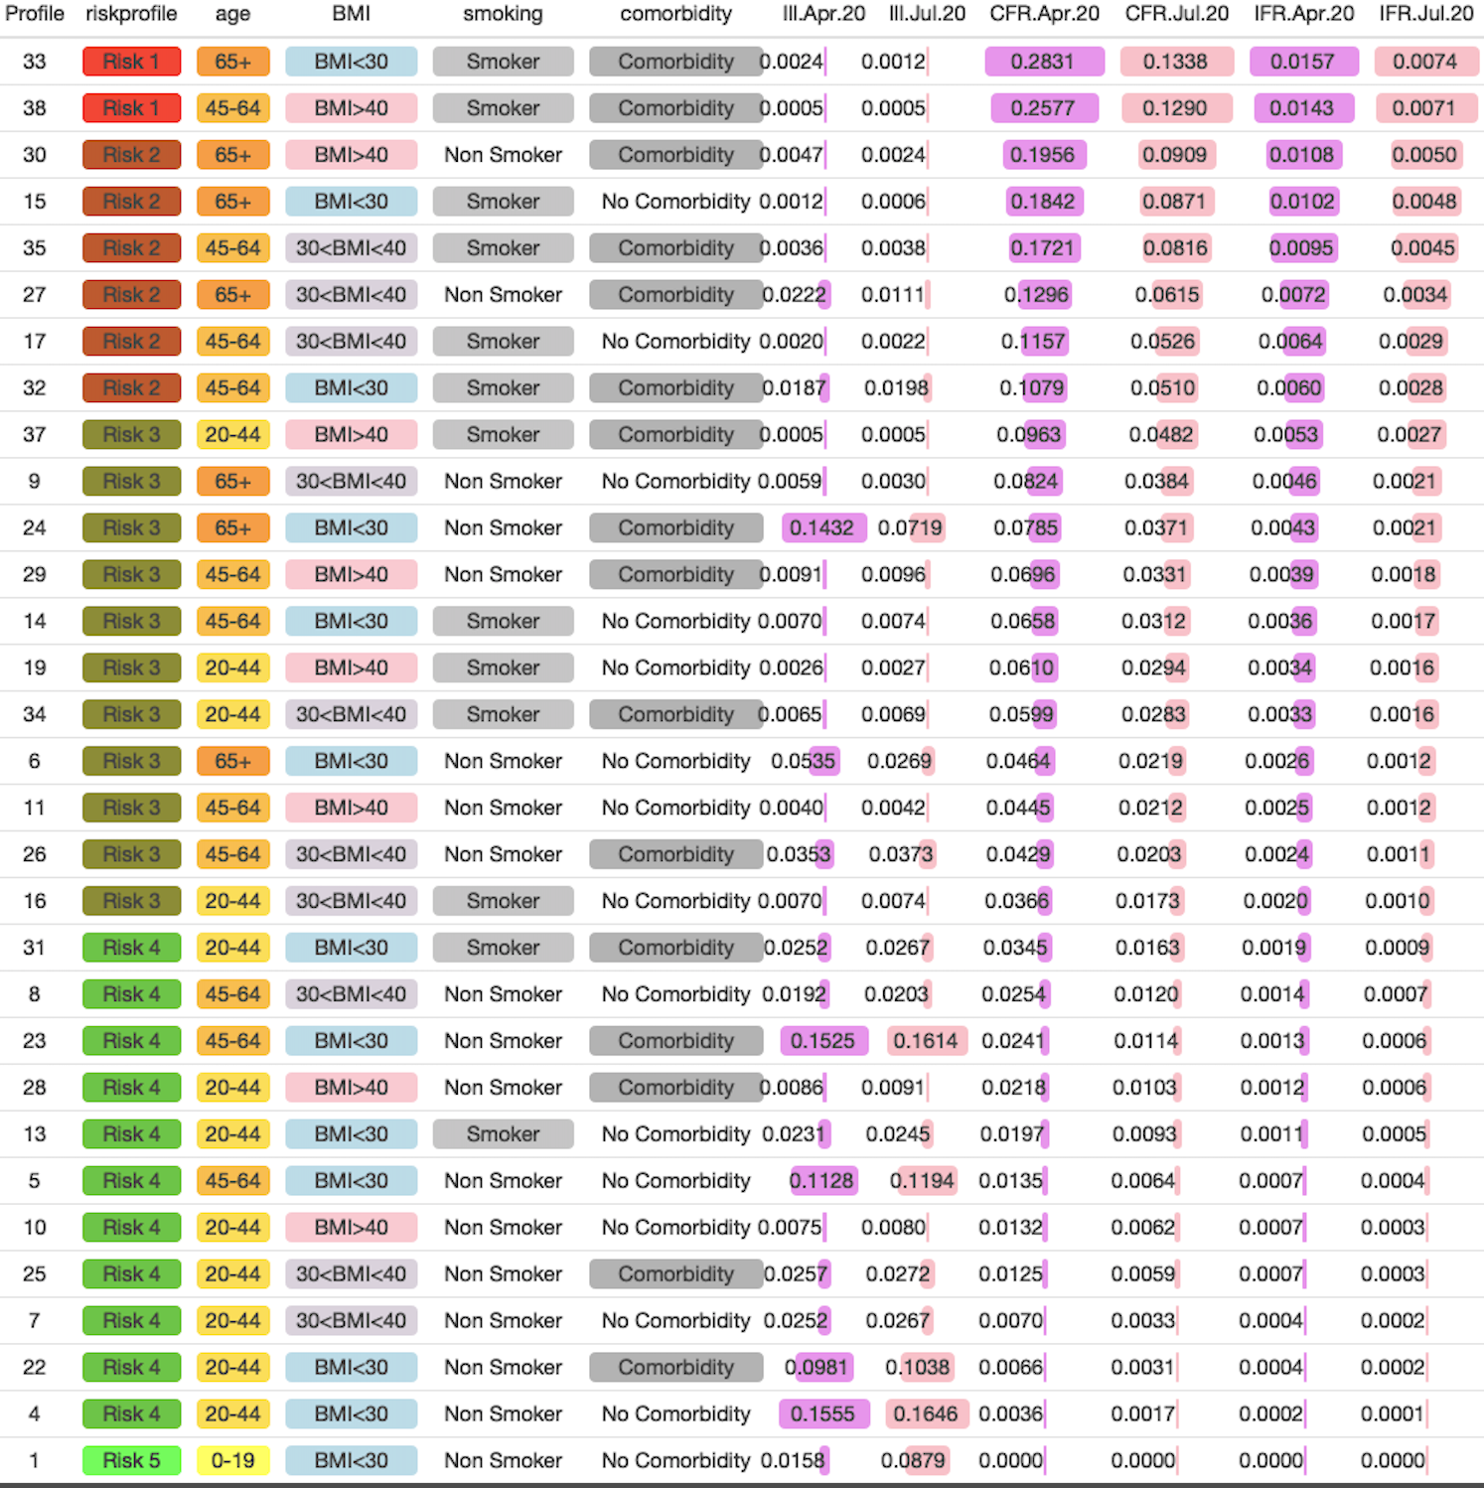
Analysis: Risk probabilities
CFR/IFR recalculated after pegging to LAC data by distribution of each age group in the infected population. It does not take into account the LAC data on deaths by age group, since these are heavily influenced by SNF cases.
Ill.Apr.20 and Ill.Jul.20 show the model-estimated prevalence of each stratified risk profile in the infected population, after accounting for the LAC observed distribution of each aggregate age group
You will note the CFR/IFR do change from Apr.20 to Jul.20, due to the overall decrease in deaths : illnesses between these dates.
I think we can replace existing CFR/IFR tables with this.
Model fit using tight priors around Prior Risk Probabilities

Slide 17
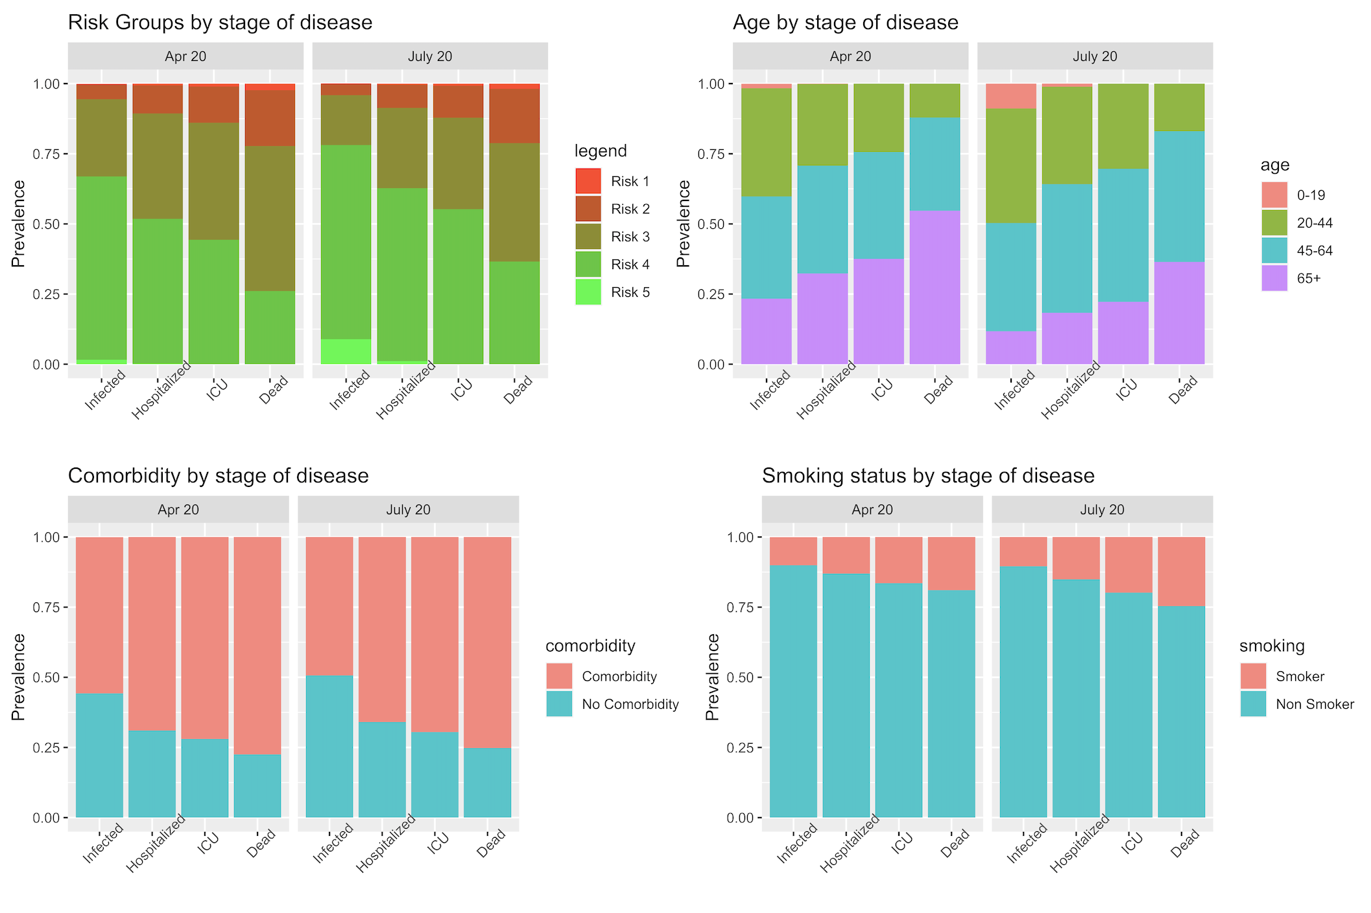
Analysis: Risk probabilities
Change in prevalence of risk groups, age groups, any comorbidity, and smoking between April 20 and July 20.
Interesting, but I’m not quite sure what the points for discussion/takeaway are…
Even as avg age decreases in overall population, still makes up a large fraction of deaths?
Other thoughts?
Include this??

Slide 18
Scenarios
## SCENARIO 0: R0 DO NOTHING (NO INTERVENTIONS: PROJECTION USING MODEL ESTIMATED PARAMETERS)
## SCENARIO 1: R0 DO NOTHING + SHIELD 65+
## SCENARIO 2: STAGE 3 SELF-ADAPTIVE Rt
## SCENARIO 3: STAGE 3 SELF-ADAPTIVE Rt + SHIELD 65+
## SCENARIO 4: CONTINUE TOTAL LOCKDOWN 1 MONTH LONGER
## SCENARIO 5: CONTINUE TOTAL LOCKDOWN 1 MONTH LONGER + SHIELD 65+
## SCENARIO 6: OBSERVED TREND
## SCENARIO 7: OBSERVED TREND Rt + SHIELD 65+

Slide 19
METHODS
For all scenarios in which at-risk populations are not isolated, we use the observed trend in the probabilities of severe illness for LAC – which decreased over time due to community self-adaptation.
We implement scenarios in which individuals 65+ are isolated, which comprise approximately 10% of the overall LAC population. In these scenarios we implement that the probabilities of severe illness are suddenly reduced as these populations are removed from the general population. This sudden reduction takes place on the same date that Stage 1 lockdown was implemented, since this is the time needed to understand we were facing a major public health crisis. We isolate these individuals from the overall community by removing them from the susceptible population, then using the risk model to recalculate the population-average probabilities of severe illness without including these populations.
I used a “realistic” approach and isolated 100% or 50% of the 65+ population out of the OBSERVED overall infections in LAC on Apr.20 and Jul.20, finding the updated Alpha Kappa Delta as … where Removed.1 is 100% and Removed.0 means 0% removed, or the original distribution. I did these calculations so that the frequency of the populations are updated at each stage. Then I ran the scenarios in which these populations are isolated by implementing the updated Alpha Kappa Delta at Apr.20 and Jul.20 — so that it parallels exactly the observed trend, but with the reduced rates.
In the scenarios for which we say that Rt follows a community self-adapted decrease, we implement that the value of Rt would have gradually reduced from R0 to the observed Rt value in Stage 3 of ~1.5, beginning in mid-July. This involves a panel of public health outreach and restriction policies (which in practice has included mask wearing, schools and indoor dining/entertainment being closed), but not as stringent as the total community lock-down of Stage 1.

Slide 20
Analysis of scenarios
@Dave: In figures from last night I had been removing individuals with 65+ and/or any comorbidities. Then I calculated that 65+ and/or comorbidities was almost 50% of the population (too many to shield) (and, I had not been removing 50% from of the susceptible population). So I repeated the analysis with 65+ only and results are around the same as last night, with slightly more deaths and more hospitalizations. So I think we should definitely present only scenario with 65+ since that is a more plausible scenario to remove!
Isolating 65+, no matter what is done to R(t), prevents a lot of deaths. Even if combined with Trump scenario of do absolutely nothing to decrease R0 (i.e. R(t) always = 4), shielding 65+ populations results in almost exactly the same total number of deaths as observed, as herd immunity is reached. However in this scenario, the numbers in hospital would have greatly surpassed capacity.
The Sweden scenario of community self-adaptive Rt that goes down to 1.5 by end of April results in slightly more deaths overall but greatly exceeds healthcare capacity. But combined with shielding 65+, this reduces overall number of deaths by around 1/3. This strategy is not recommended, however, as it still leads to substantially overwhelming healthcare facilities.
Interestingly, extending total lockdown by 1 month makes very little difference to observed deaths and hospitalizations. But extending total lockdown by 1 month + shielding 65+ makes a huge impact to reducing deaths – averting ~90% of observed deaths.
However keeping the observed course in terms of restrictions in contact for the general community without extending total lockdown by 1 month (i.e., Rt is what was observed for LAC), but shielding those 65+, could have had a very similar effect, averting ~80% of observed deaths.

Slide 21
Discussion
Main conclusion: the early stay at home saved many lives because it both reduced transmission and protected the elderly. A more relaxed initial lockdown but more strict protection of the elderly could have also averted many deaths, however at the expense of exceeding healthcare capacity, thus likely leading to more severe illnesses and deaths not accounted for by this model. Doing nothing to decrease R0 but still protecting the elderly would have so significantly overwhelmed healthcare capacity as to almost certainly result in disrupting the healthcare system in LAC and a large number of additional deaths. Thus the main takeaway is that strict initial restrictions to society were key, and that it is ok to relax these so long as the outbreak continues to remain more prevalent in younger less at-risk populations and older and other vulnerable populations are shielded. In anticipation of an upcoming increase in cases this fall, it will be important to ramp up efforts to protect the 65+ and vulnerable populations while maintianing moderate community-level restrictions .
If we use both 65+ and the observed alpha, kappa, delta scenarios, showing only deaths (not hospitalizations): We can make the point that we could have reduced a lot of deaths if we started early on by protecting 65+, but perhaps that is unrealistic; so then we show what it would have looked like if we started eearly on protecting whomever we’re protecting now (which is by definition realistic). Message is: whatever we do makes a difference, it’s not all or nothing, but we need to do something to protect the at-risk! (edited)
Generalizability: We do this analysis for LAC. This analysis could be generalized to different regions, which will have different percentages of at-risk individuals, to understand the combined impact of community + specific subpopulation interventions based on the region-specific distribution of vulnerable populations in each subpopulation.
Limitations:
It is important to note that in the scenarios in which the 65+ population is shielded, we implement this by operating only on numbers of infection, hospitalizations and deaths.
We do not account for the health impact of COVID that do not require hospitalization, including long term effects.
We also do not account for critical illnesses or deaths that could result from healthcare capacity being exceeded.
We assume the protection scenario is model is an 100% effective implementation

Slide 22
TO DO + QUESTIONS
Show R(t) for each scenario (in 1 plot)
Show Alpha/Kappa/Delta(t) for each scenario in 1 plot?? Maybe just the composite calculated P(D|I)?
Which compartments to show trends for in paper? I am undecided because it is interesting to see the comparisons with observed data, but it is also interesting to see the current in compartment, esp. for hospitalizations and illnesses.
Maybe:
New Infections (vs. data), Cumulative Infections (vs. data)
New Hospitalizations (vs. data), Current Hospitalizations (with capacity line)
Cumulative Deaths (vs. data)

Slide 23
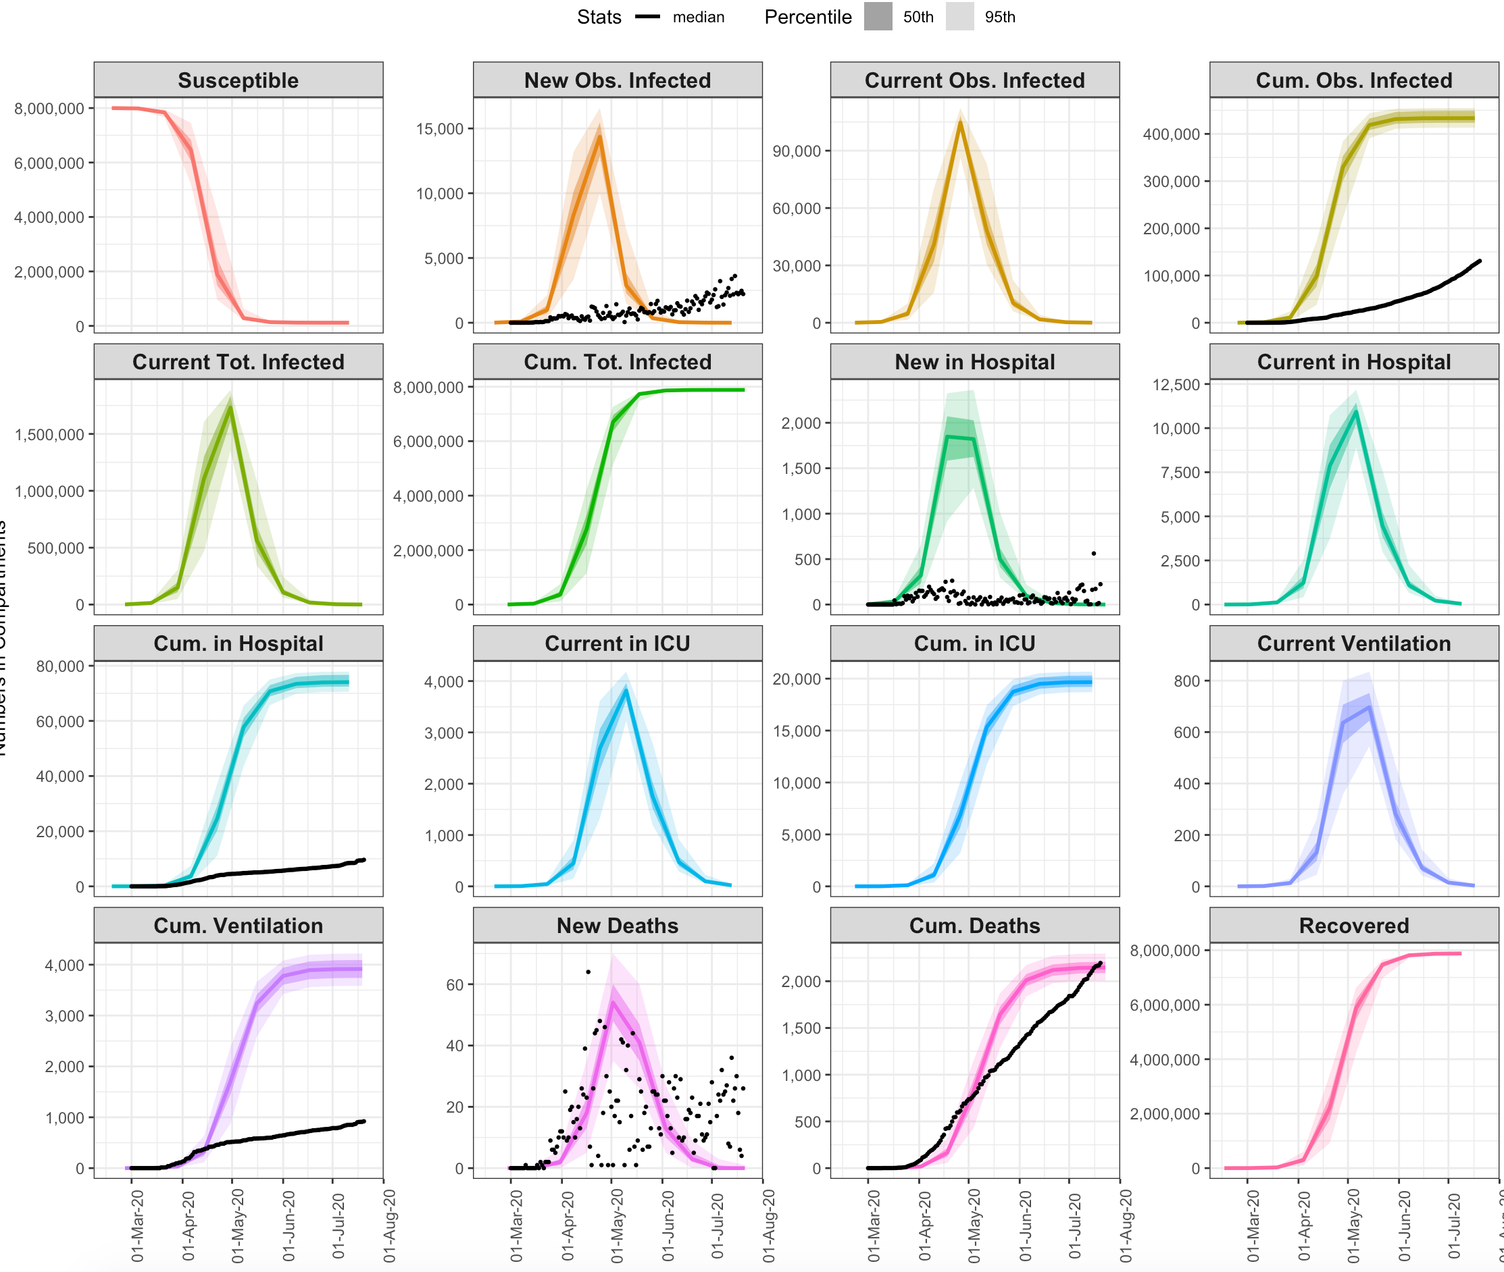
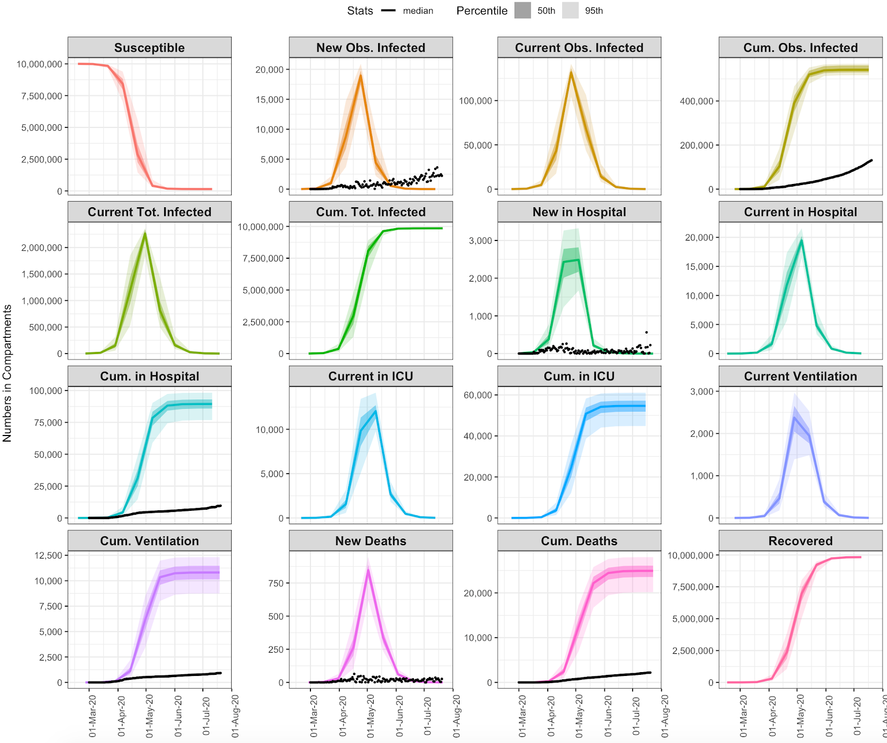
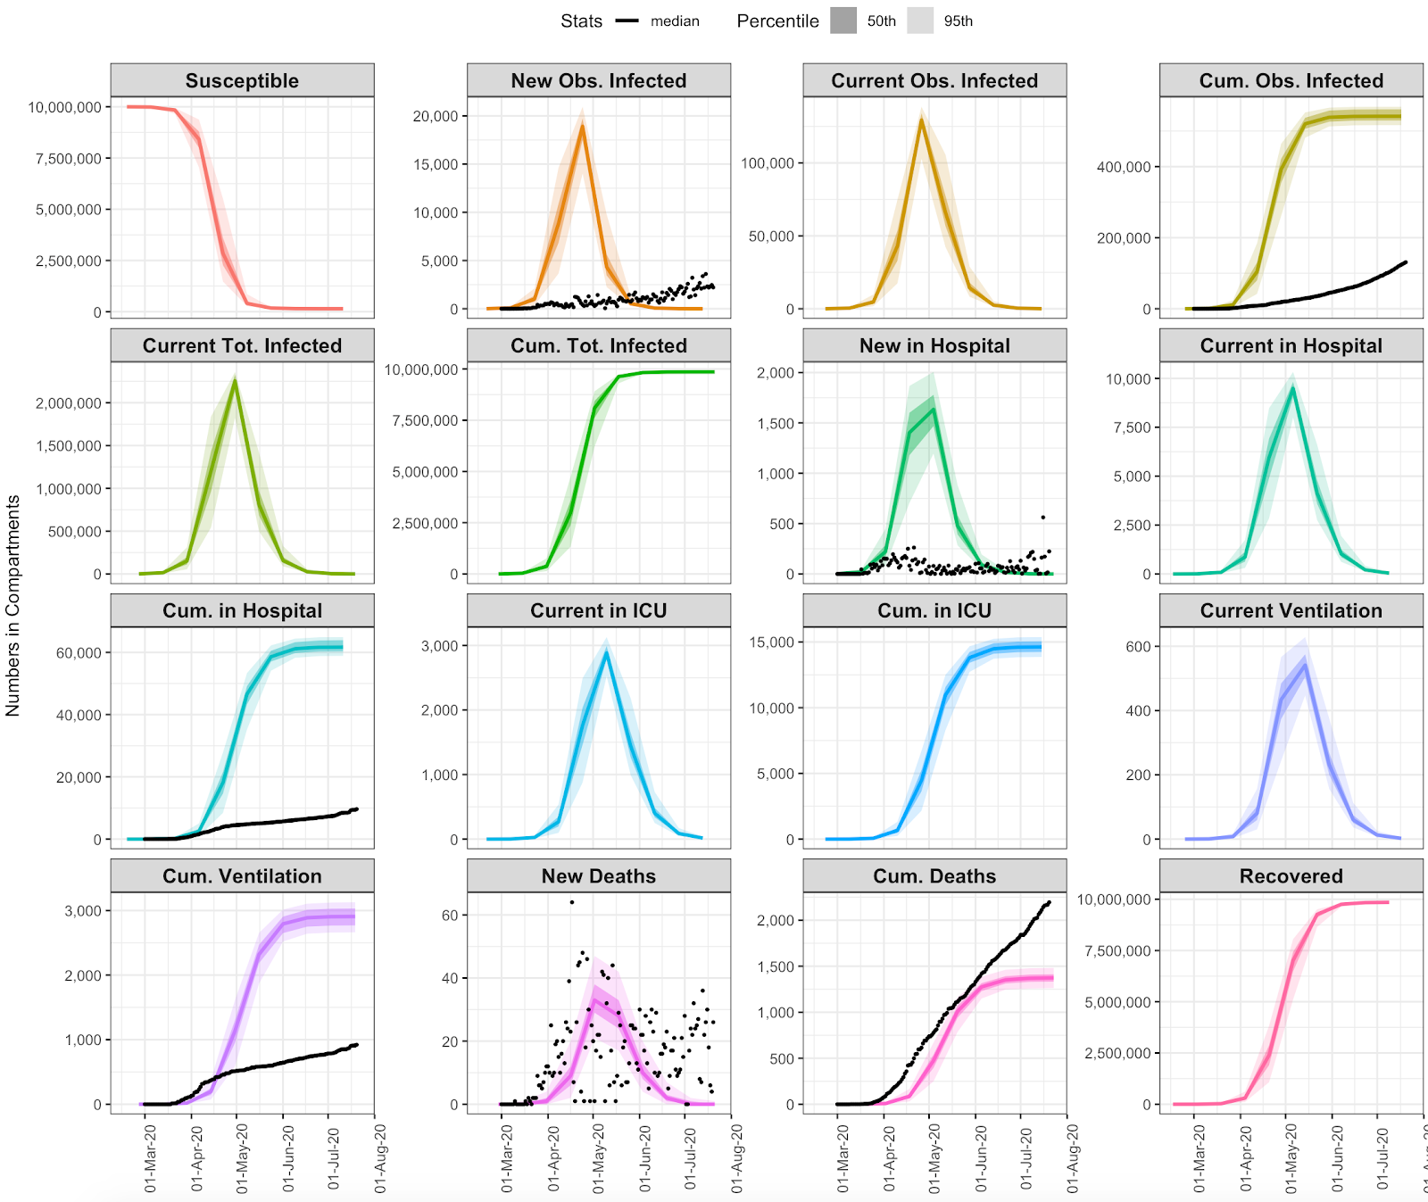
## SCENARIO 0: R0 DO NOTHING
(Trump Scenario)
## SCENARIO 1: R0 DO NOTHING + SHIELD SPECIFIC POPULATIONS

Slide 24
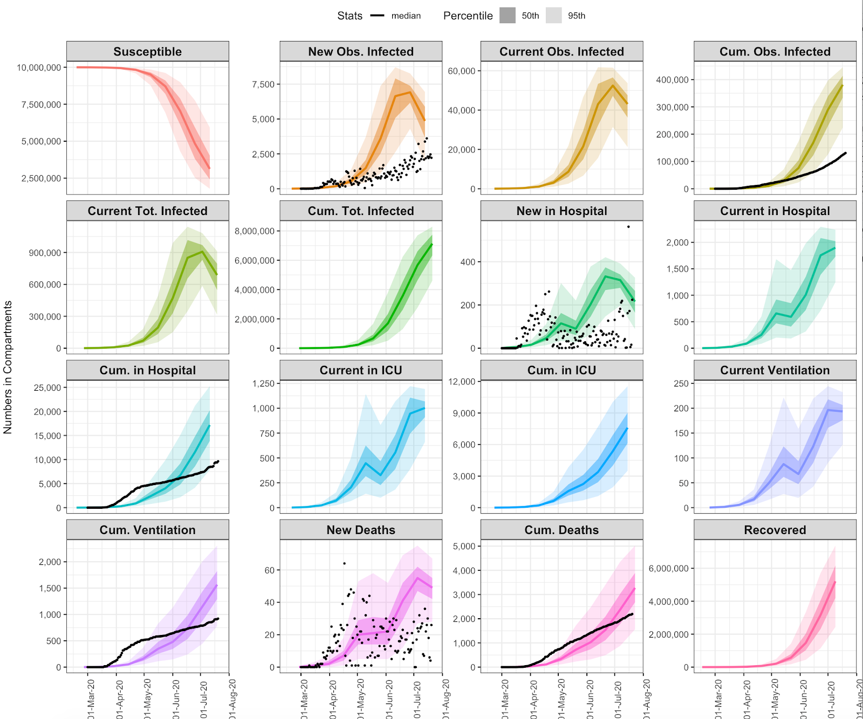
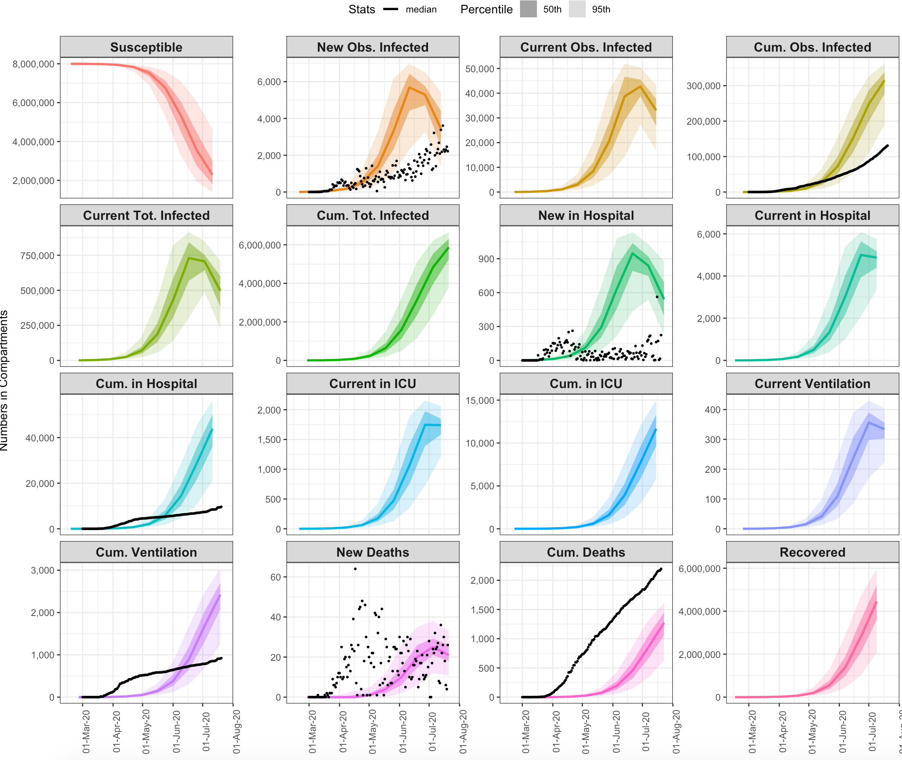
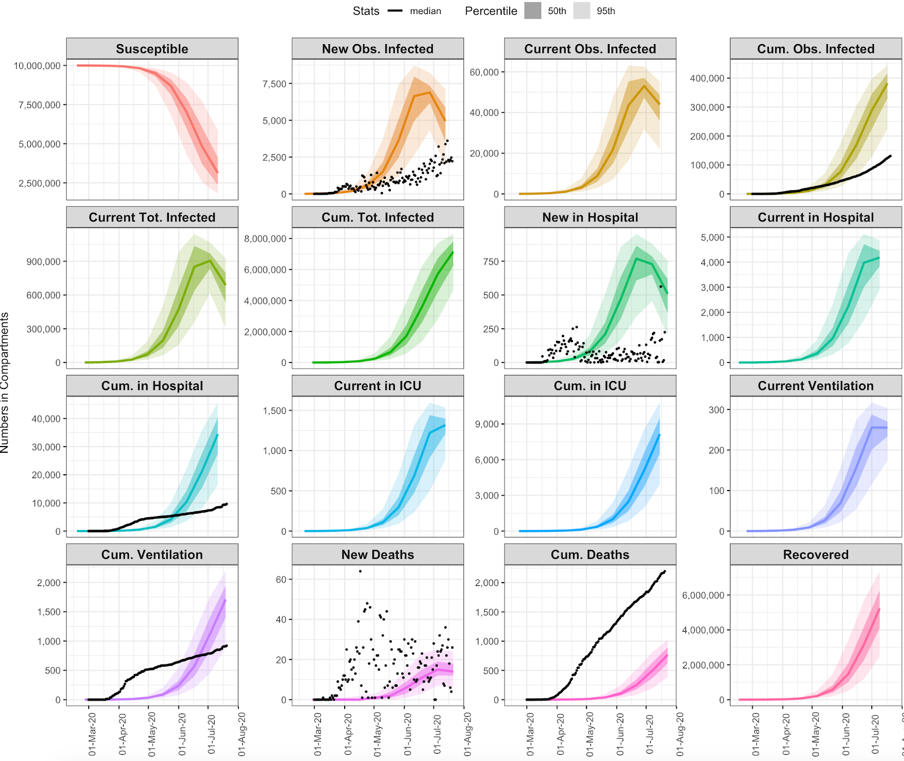
## SCENARIO 2: STAGE 3 SELF-ADAPTIVE Rt (go almost immediately into Stage 3)
## SCENARIO 3: STAGE 3 SELF-ADAPTIVE Rt + SHIELD SPECIFIC POPULATIONS (this is what I would call Sweden Scenario)

Slide 25
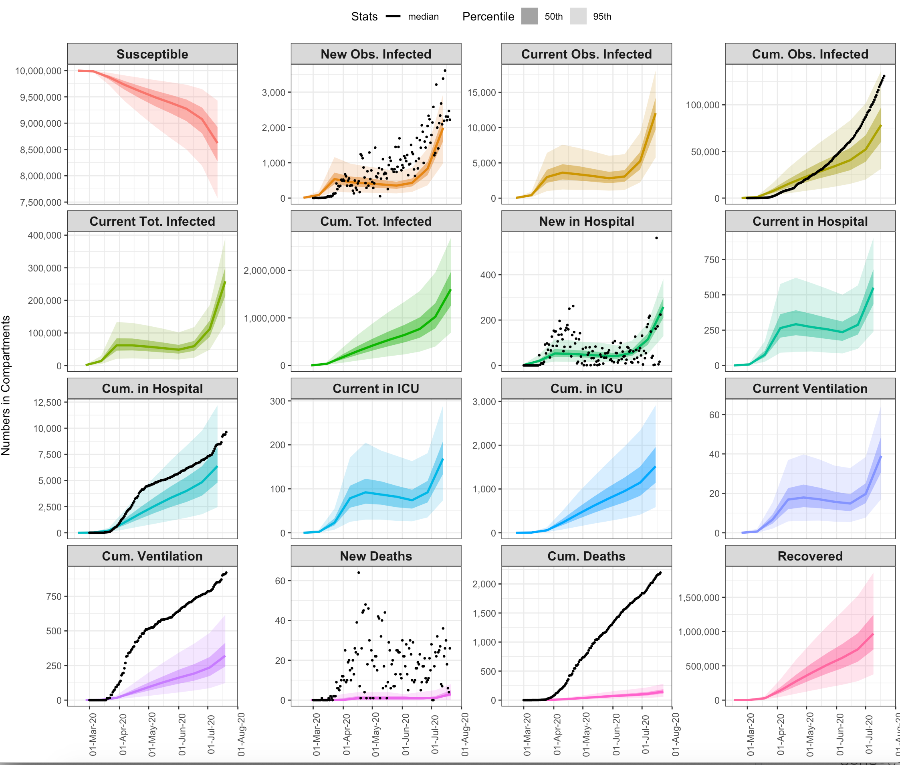
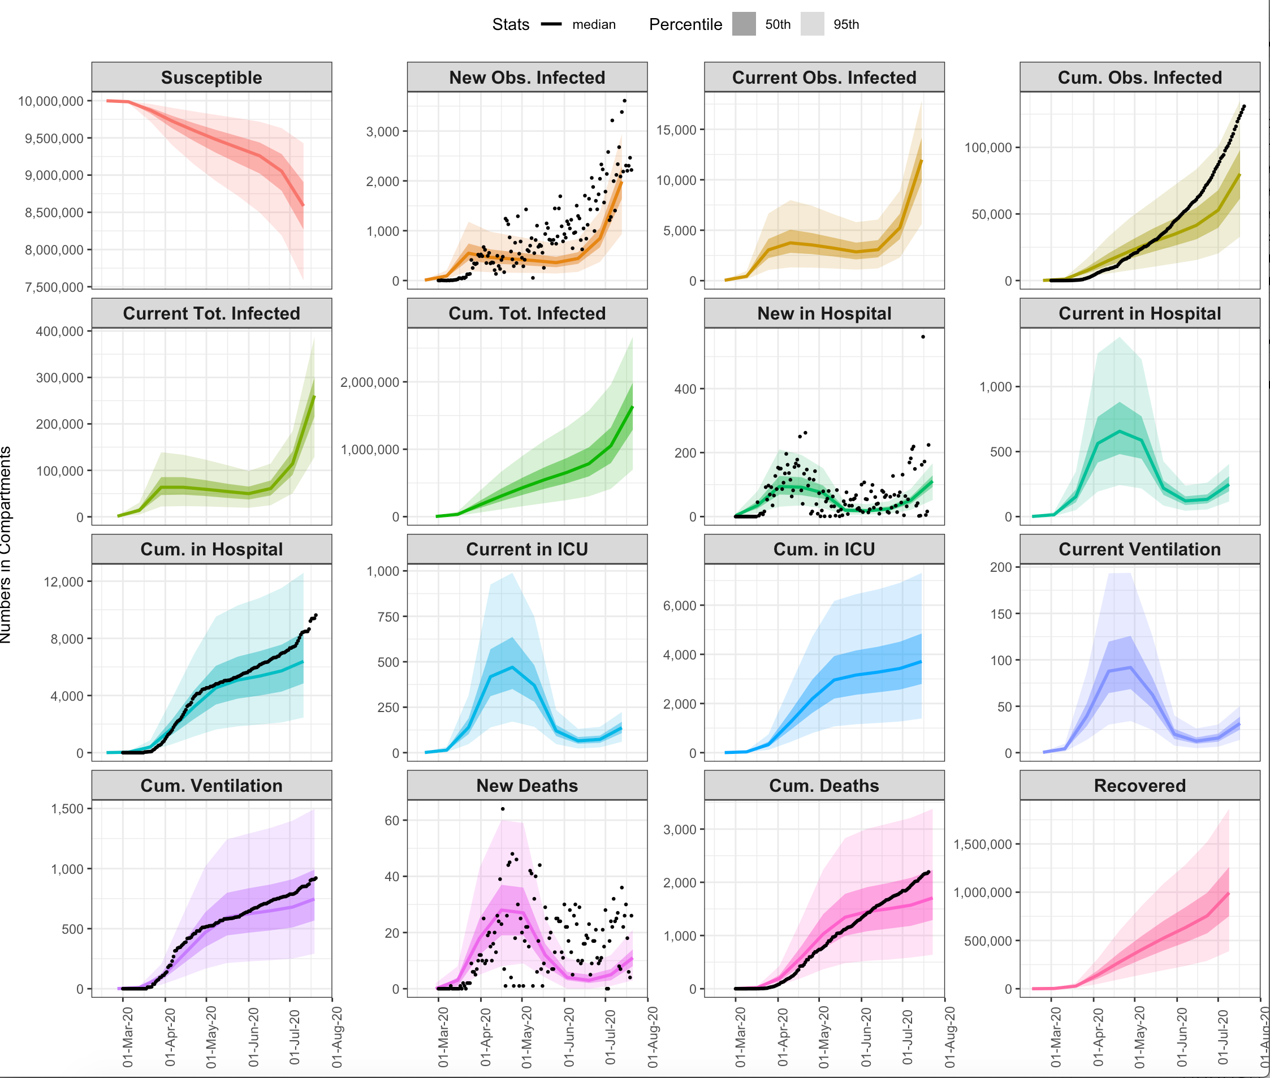
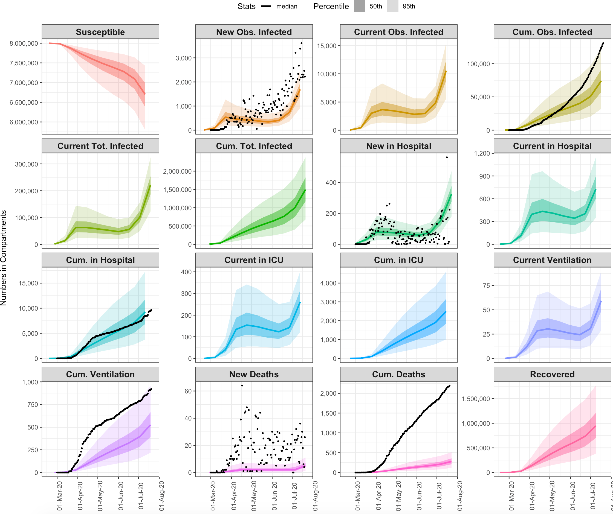
## SCENARIO 4: CONTINUE TOTAL LOCKDOWN 1 MONTH LONGER
## SCENARIO 5: CONTINUE TOTAL LOCKDOWN 1 MONTH LONGER + SHIELD SPECIFIC POPULATIONS

Slide 26
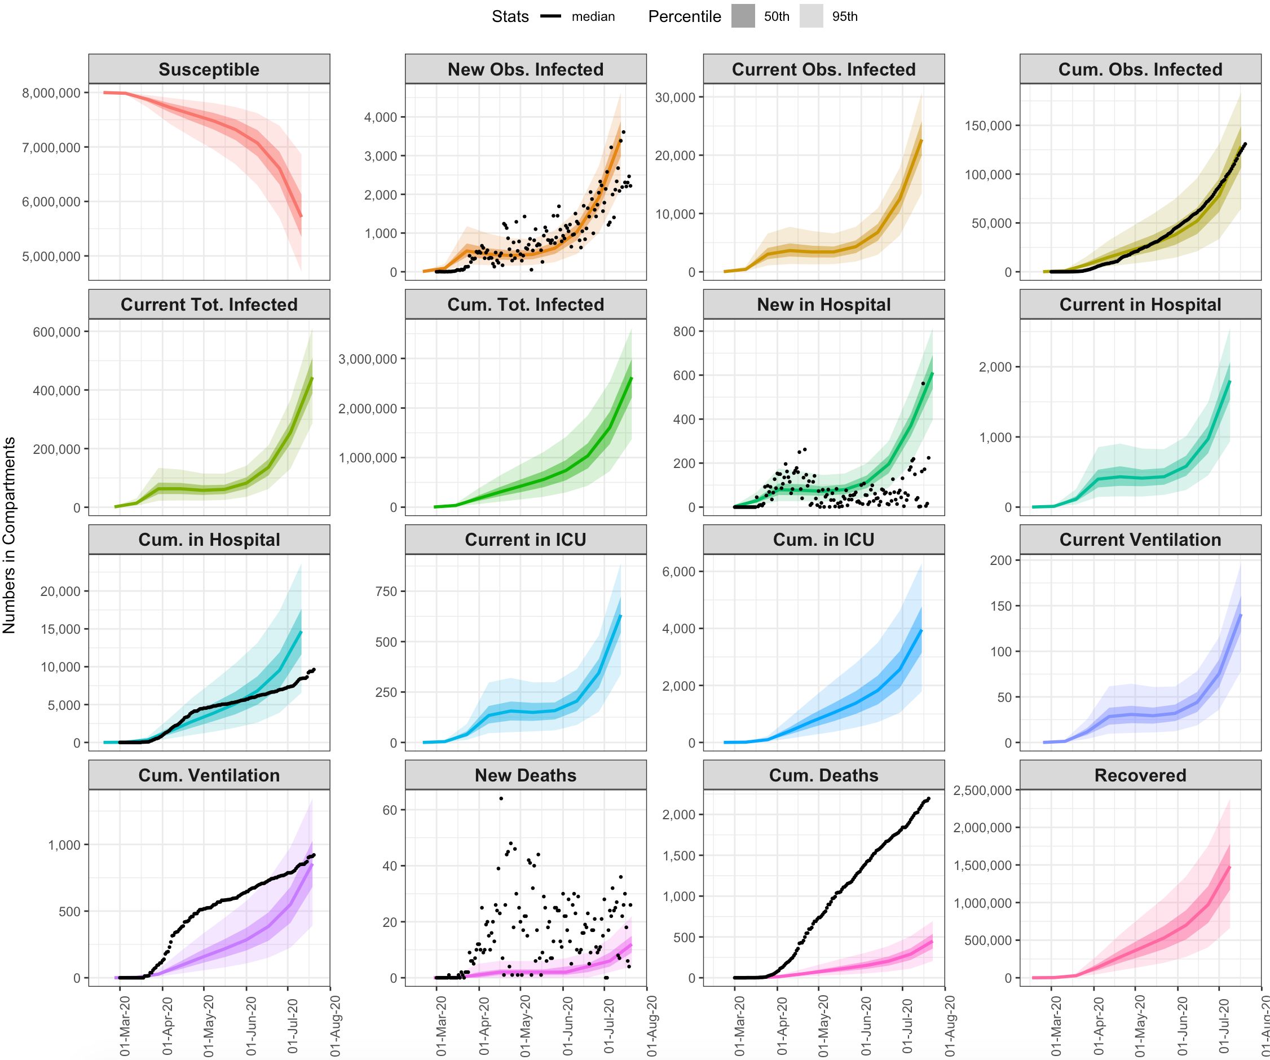
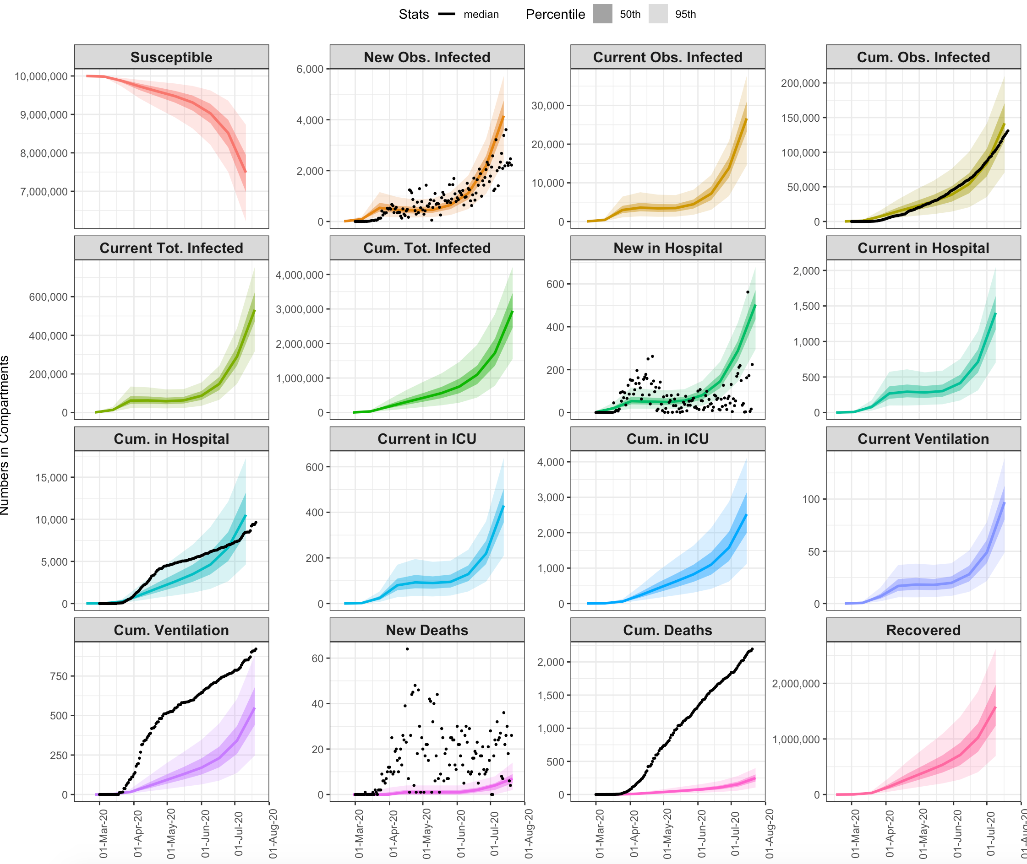
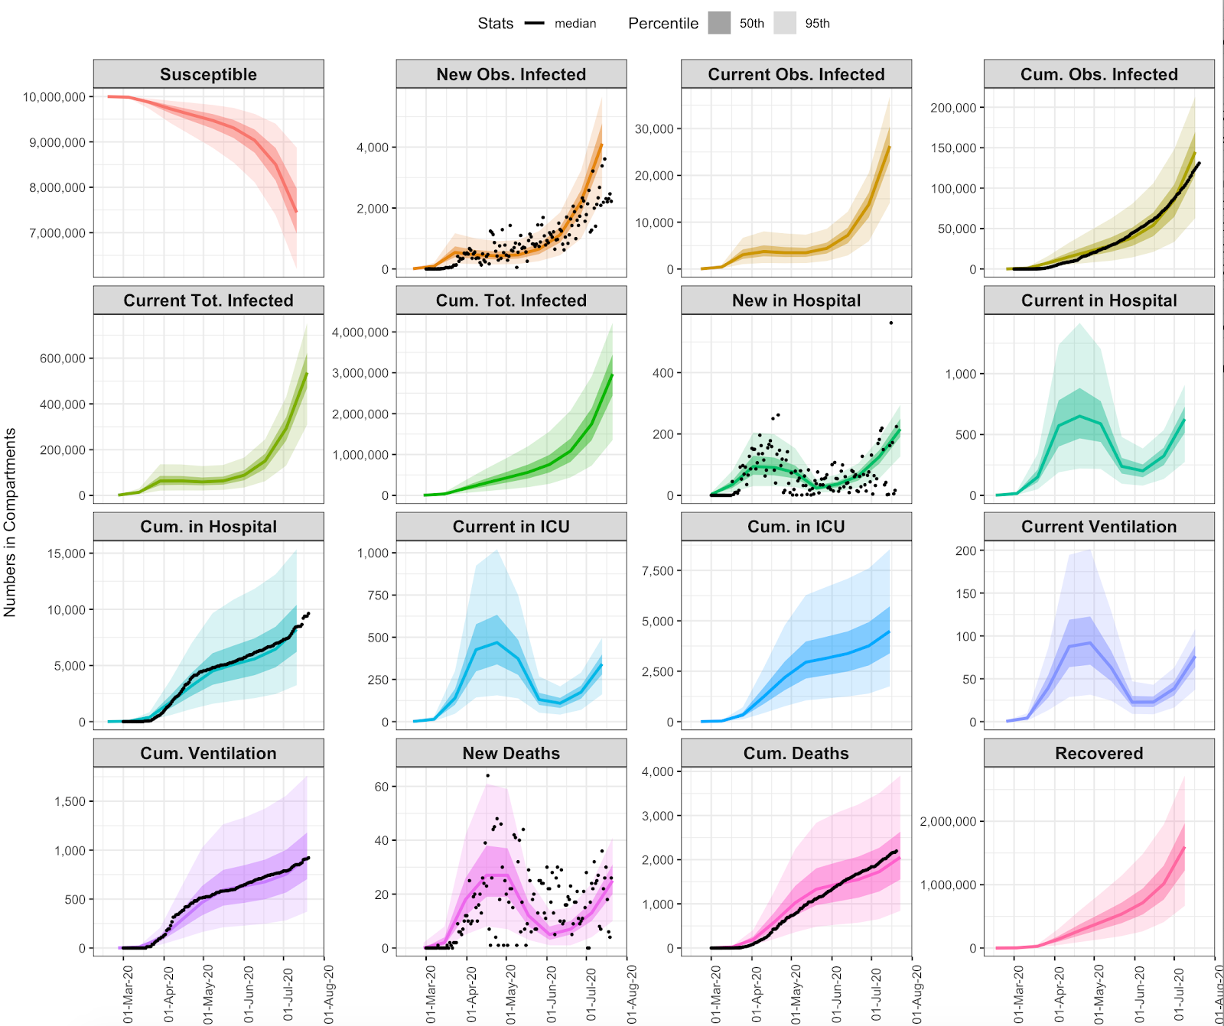
## SCENARIO 6: OBSERVED TREND Rt
## SCENARIO 7: OBSERVED TREND Rt + SHIELD SPECIFIC POPULATIONS

